Slide 1
Chapter 19: Hermite
Figures from
Computer Graphics through OpenGL – from Theory to Experiments, 3rd Edition
by Sumanta Guha

Slide 2
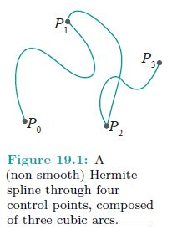

Slide 3
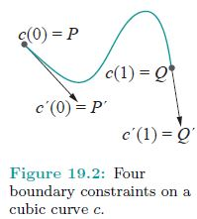

Slide 4
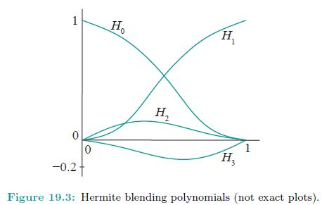

Slide 5
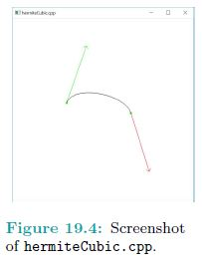

Slide 6
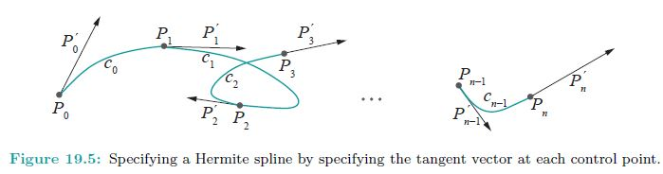

Slide 7
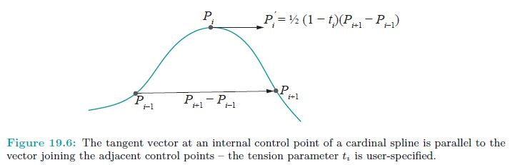

Slide 8
